Slide 1

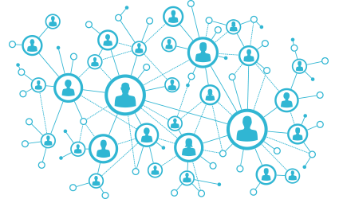
Community-scale Online Network Analysis of Social Data Streams
Ammar Raşid
Assoc Prof. Ahmet Bulut

Slide 2
Outline
Introduction & Motivation
Problem Definition
System Overview
Current Findings
Next Goals
Conclusion

Slide 3
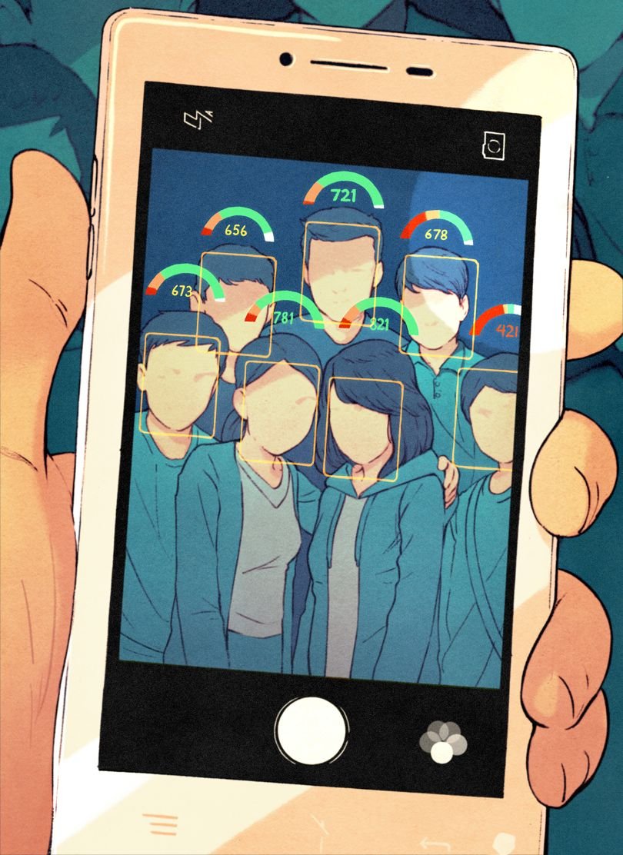
Introduction & Motivation
China’s Social Credit system

Slide 4
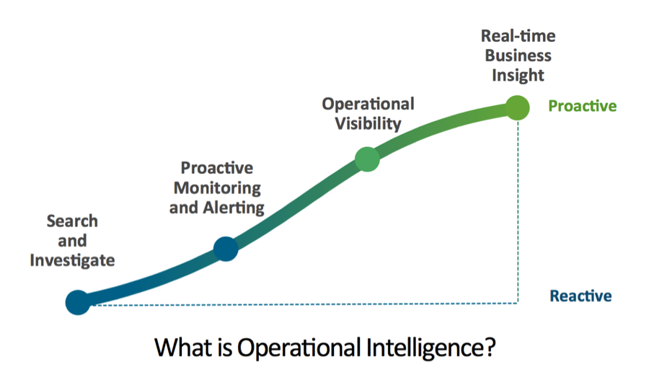
splunk.com

Slide 5
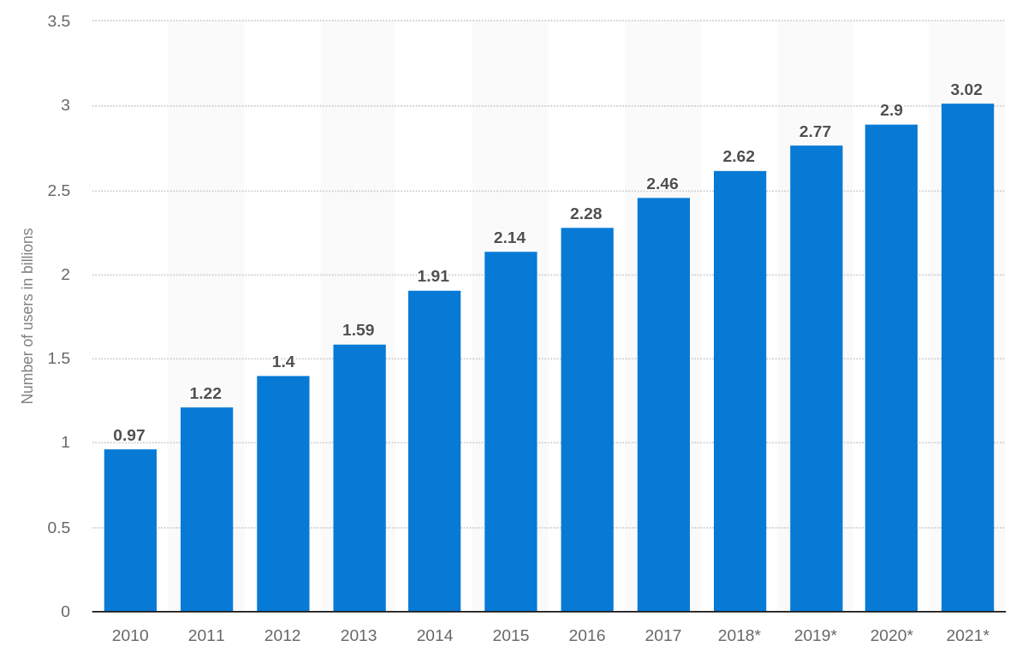
Increasing Social Media Presence

Slide 6

Problem Definition
Given:
Construct a Network:
Chronological
Contextual
Smart
Social data streams

Slide 7
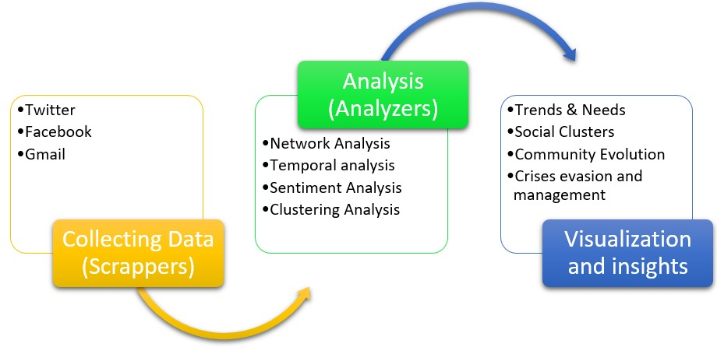
System Overview

Slide 8
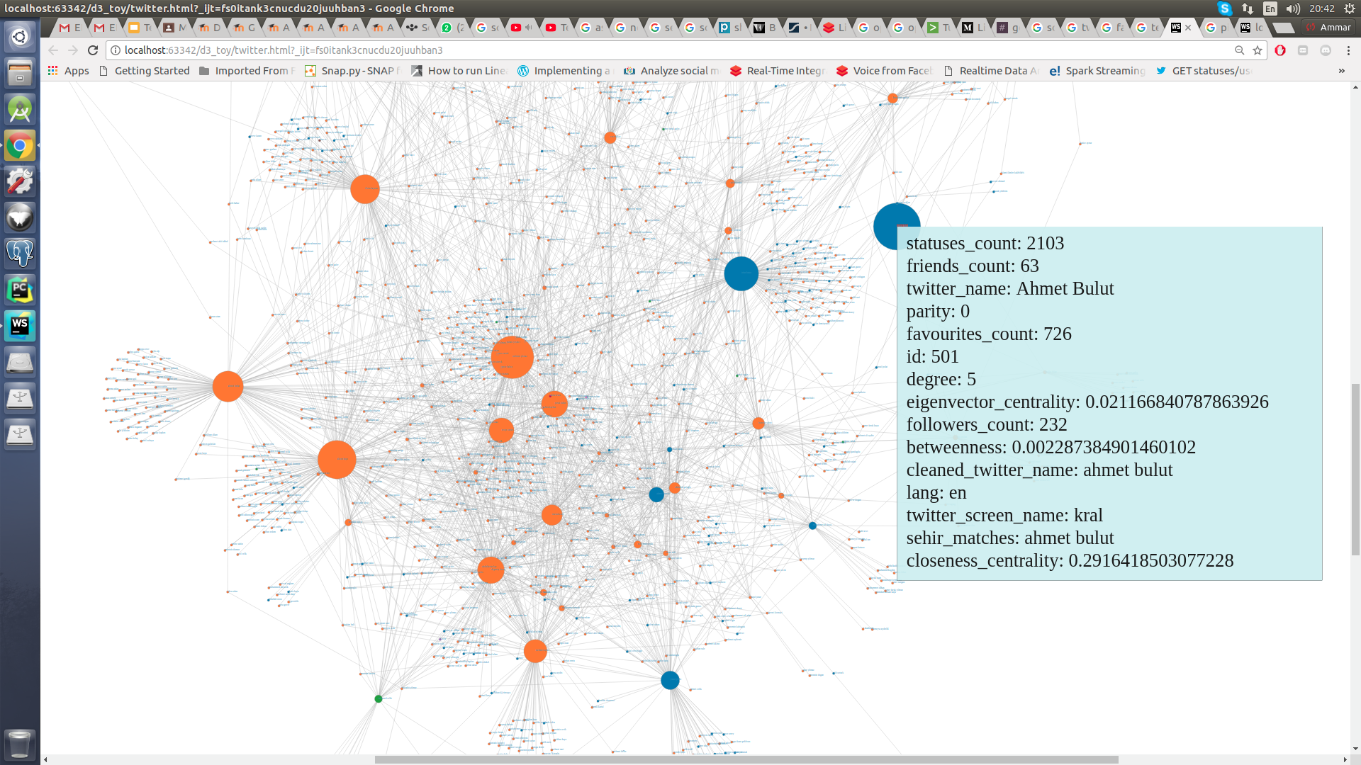

Network Analysis

Slide 9
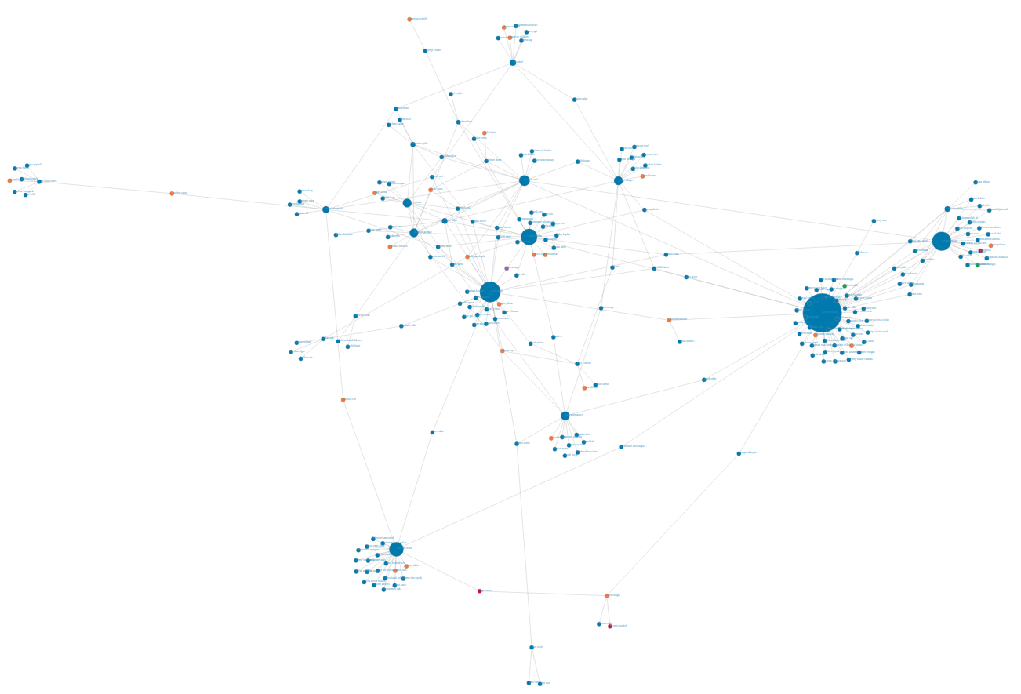

Network Analysis

Slide 10
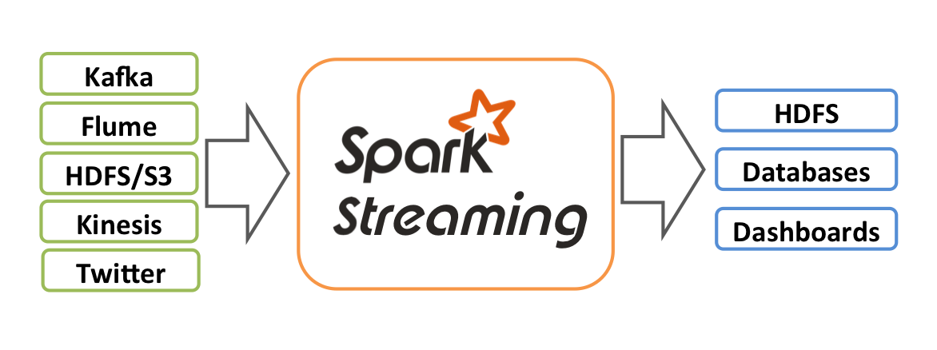
Next Goals
Online Clustering

Slide 11
Acknowledgements
Prof. Ferhat Kentel
Prof. Mustafa Özel
Prof. Mehmet Akif Kayapınar
Ahmet Öztemiz
Abdullah İhsan Seçer
Abdurrahman Talaat
Mustafa Bera Akay
Selma Slocum
Somaya Gamal

Slide 12
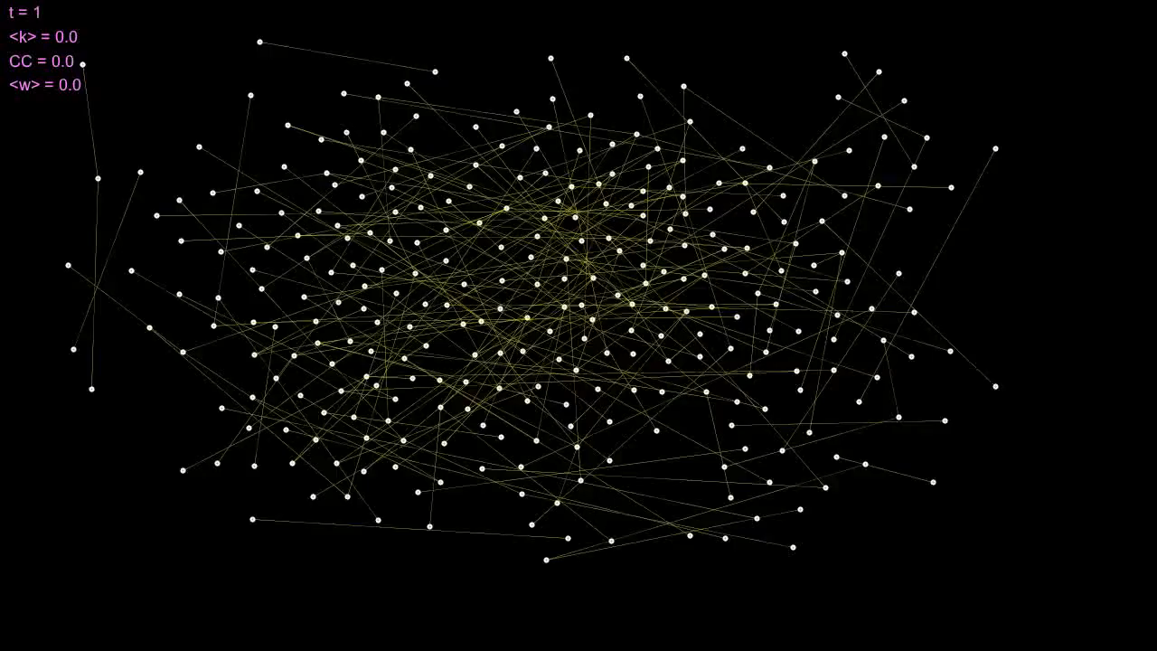
Dynamic Network Analysis

